Slide 1
CUSTOMER CHURN ANALYSIS
SUBMITTED BY
Alipta Basak
Antara Ray
Bratati Ghosh
Mohini Das

Slide 2
ABOUT THE PROJECT:
The telecommunications sector has become one of the main industries in developed countries.
The technical progress and the increasing number of operators raised the level of competition . Companies are working hard to survive in this competitive market depending on multiple strategies.
Customers’ churn is a considerable concern in service sectors with high competitive services . On the other hand , predicting the customers who are likely to leave the company will represent potentially large additional revenue source if it is done in the early phase.
This project gives an opportunity to predict churnes and non-churners.

Slide 3
OUTLINE
Business Problem
Variable Description
Exploratory Data Analysis
Feature Selection
Data Pre-Processing
Model Development
Model Validation

Slide 4
BUSINESS PROBLEM
Consumers today go through a complex decision making process before subscribing to any one of the numerous Telecom service options.
The service provided by the Telecom vendors are not highly differentiated and number probability is commonplace.
Customer loyalty becomes an issue. Hence , it is becoming increasingly important for tele-communications companies to proactively identify factors that have a tendency to unsubscribe and take preventive measures to retain customers.

Slide 5
VARIABLE DESCRIPTION
st - state
acclen - account length
arcode - area code
phnum - phone number
intplan - internet plan (yes/no)
voice - voice
nummailmes - no of email messages
tdmin - total day messages
tdcal - total day time calls
tdchar - total day time charges
temin - total evening time minutes
tecal - total evening time calls
tecahr - total evening time charges
tnmin - total night time minutes
tn cal - total night time calls
tnchar - total night time charges
timin - total international minutes
tical - total international calls
tichar - total international charges
ncsc - no. of customer services calls
label - Churned? (true/false)

Slide 6
Few observation from exploratory analysis
Customers with Internet Plan tend to churn most frequently.
Customers with more Customer Service Calls churn more than do the other customers.
Total night time calls of a customer does not influence the label.

Slide 7
Feature selection
Important features were identified during model building process:
-Using Box-Plot and Feature Selection(SelectKBest) we identified the important variable to consider.
-The important features are:intplan,ncsc,nummailmes,tdmin,tdchar,voice,temin,techar,tichar,timin,tical,tnchar.

Slide 8
DATA PRE-PROCESSING
First we have removed all spaces from the dataset.
We have two separate datasets for training and testing. So we did not perform the data partioning operation.
We have converted the string series intplan and voice to its equivalent integer series.
We have deleted some unnecessery values from ncsc series.
We have dropped following eight variables as they are not adding any meaning for modeling purpose:
-State
-Area-code
-Phone number
-Account length
-Total night time calls
-Total evening time calls
-Total night time minutes
-Total day time calls

Slide 9
Model : Decision Tree
Easy to interpret
Generates if-else business rules
Recursive partitioning and classification technique is used
Tree build
- Fully grown(results in overfitting of data)
- Pruned tree(optimal tree)

Slide 10
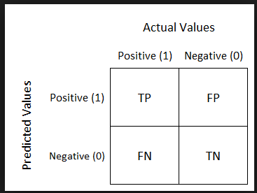
CONFUSION MATRIX

Slide 11
PERFORMANCE MEASUREMENT
Precision score = TP/(TP+FP)
Recall score = FP/(TP+FN)
For our project we have to minimise the value of False Negative . Decrease in FN results in increase in Recall. So we need high Recall value for our project.
Decision Tree gives the best Recall value for this project. So we consider Decision Tree model to predict the value for the label(churn/non-churn).

Slide 12
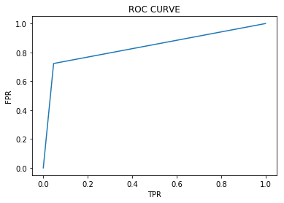
VALUE OF THE STATISTICS
MODEL NAME | ACCURACY | PRECISION | RECALL | AUC
DECISION TREE-TRAIN | 1.00000 | 1.00000 | 1.00000 | 1.00000
DECISION TREE-TEST | 0.927415 | 0.730942 | 0.727679 | 0.843049

Slide 13
CONCLUSION
The importance of this type of research in the telecom market is to help companies make more profit. It has become known that predicting churn is one of the most important sources of income to telecom companies.
These prediction models need to achieve high AUC values. We have applied feature engineering, effective feature transformation and selection approach to make the features ready for machine learning algorithms. The method of preparation and selection of features had the biggest impact on the success of this model, since the value of AUC is reached 83.33%.
Decision tree model achieved the best results in all measurements. The AUC value was 83.33%.

Slide 14
THANK YOU

